Slide 1
Fenwick tree

Slide 2
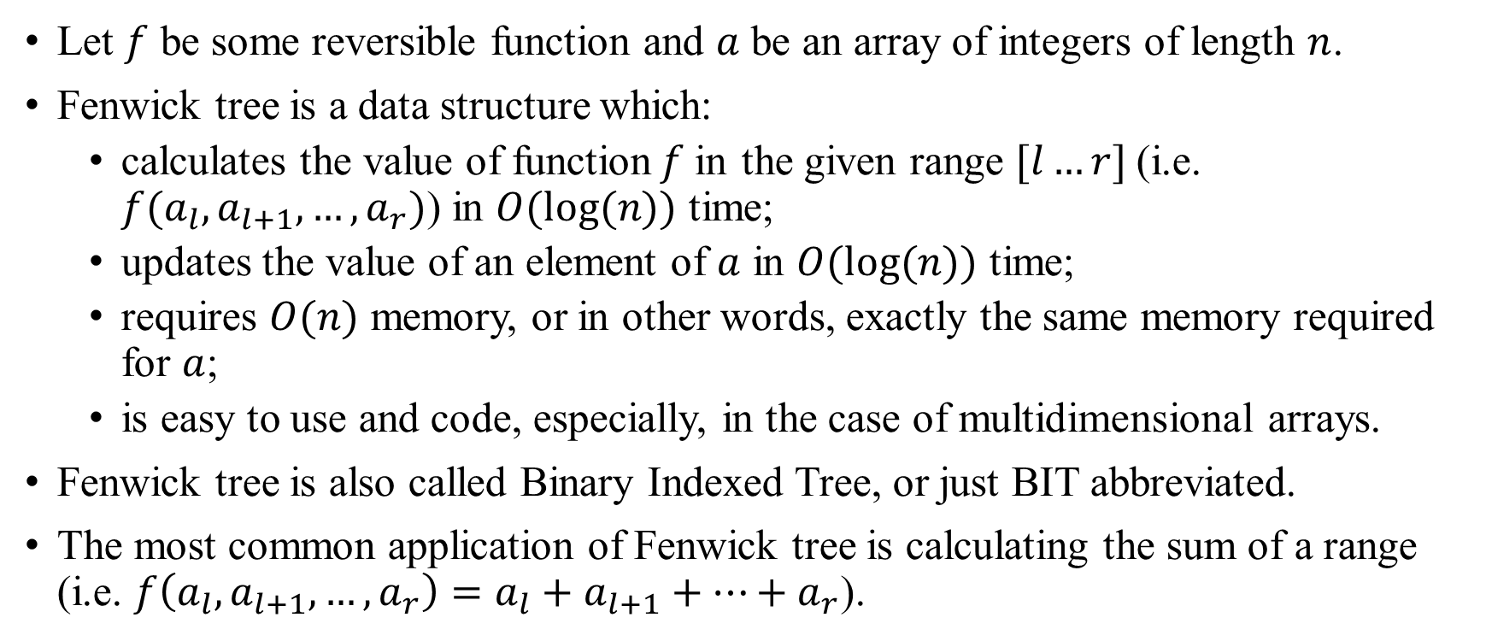
Fenwick tree
Let $f$ be some reversible function and $a$ be an array of integers of length $n$.
Fenwick tree is a data structure which:
calculates the value of function$f$in the given range $[l…r]$(i.e. $f(a_{l}, a_{l+1},…,a_{r})$) in $O(log⁡(n))$ time;
updates the value of an element of $a$ in $O(log⁡(n))$ time;
requires $O(n)$ memory, or in other words, exactly the same memory required for $a$;
is easy to use and code, especially, in the case of multidimensional arrays.
Fenwick tree is also called Binary Indexed Tree, or just BIT abbreviated.
The most common application of Fenwick tree is calculating the sum of a range (i.e. $f\left(a_{l}, a_{l+1},…,a_{r}\right)=a_{l}+a_{l+1}+…+a_{r}$).

Slide 3
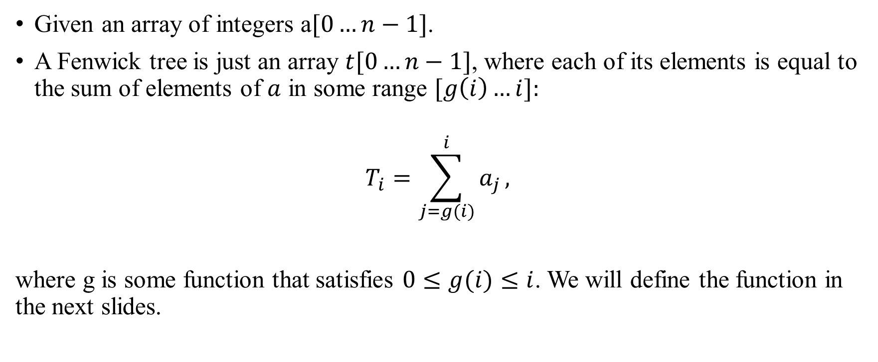
Fenwick tree Description
Given an array of integers a$[0…n−1]$.
A Fenwick tree is just an array $t[0…n−1]$, where each of its elements is equal to the sum of elements of $a$ in some range $[g\left(i\right)…i]:$
$$T_{i}=\sum_{j=g(i)}^{i}{a_{j}},$$
where g is some function that satisfies $0≤g(i)≤i$. We will define the function in the next slides.

Slide 4
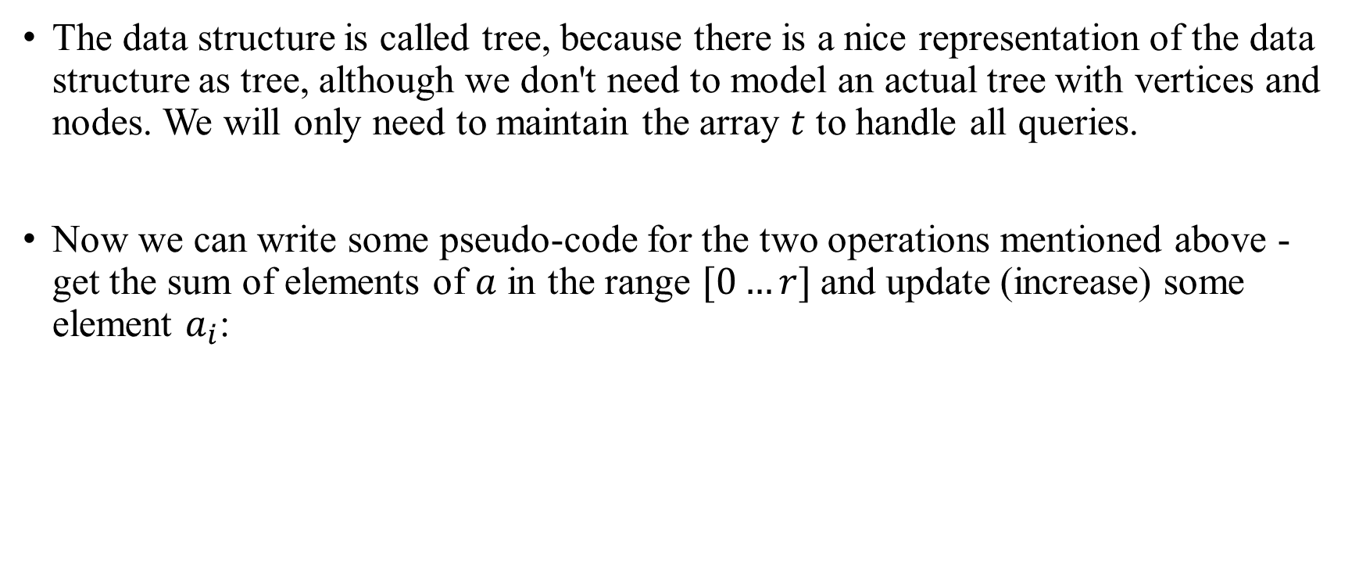
Fenwick tree Description
The data structure is called tree, because there is a nice representation of the data structure as tree, although we don't need to model an actual tree with vertices and nodes. We will only need to maintain the array $t$ to handle all queries.
Now we can write some pseudo-code for the two operations mentioned above - get the sum of elements of $a$ in the range $[0…r]$and update (increase) some element $a_{i}$:

Slide 5
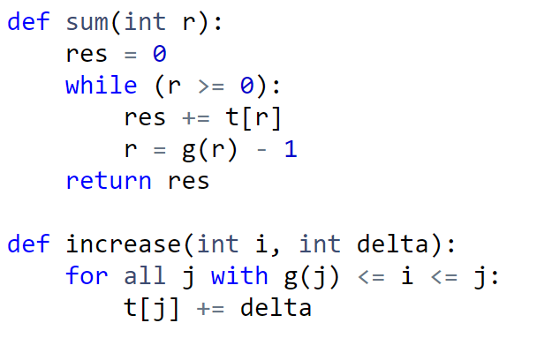
Fenwick tree Description

Slide 6
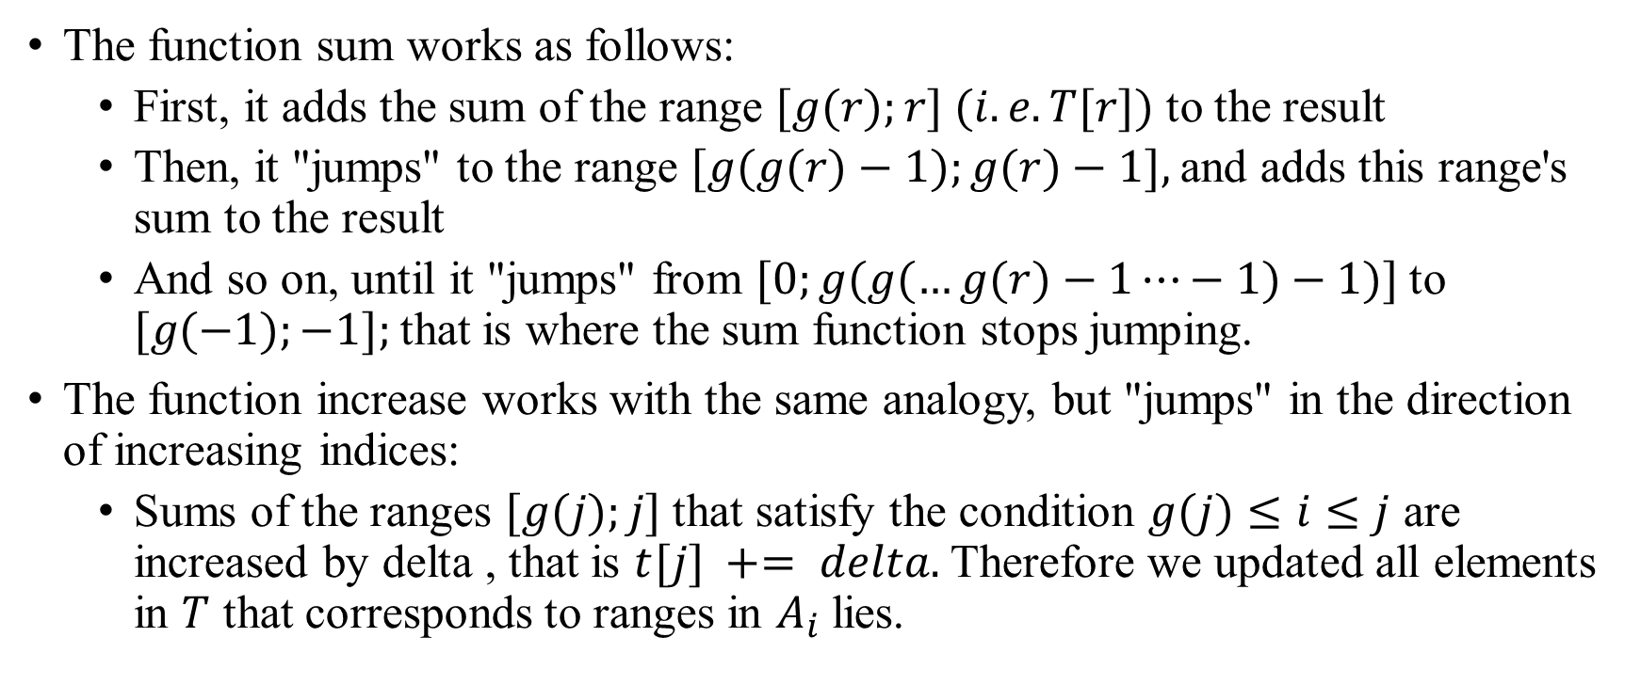
Fenwick tree Description
The function sum works as follows:
First, it adds the sum of the range $[g(r);r] (i.e. T[r])$ to the result
Then, it "jumps" to the range $[g(g(r)−1);g(r)−1],$and adds this range's sum to the result
And so on, until it "jumps" from $[0;g(g(…g(r)−1⋯−1)−1)]$to $[g(−1);−1];$that is where the sum function stops jumping.
The function increase works with the same analogy, but "jumps" in the direction of increasing indices:
Sums of the ranges $[g(j);j]$that satisfy the condition $g(j)≤i≤j$ are increased by delta , that is $t[j] += delta.$Therefore we updated all elements in $T$ that corresponds to ranges in $A_{i}$lies.

Slide 7
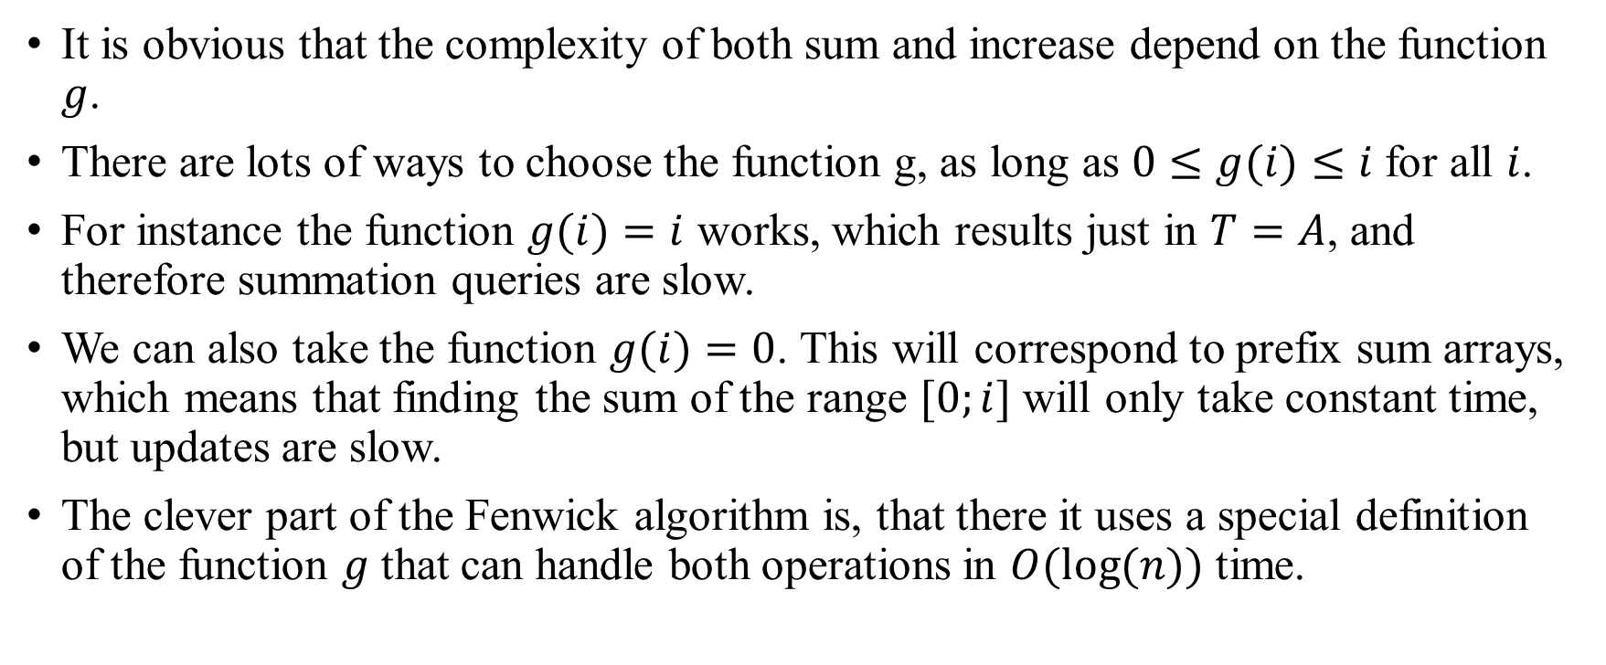
Fenwick tree Description
It is obvious that the complexity of both sum and increase depend on the function $g$.
There are lots of ways to choose the function g, as long as $0≤g(i)≤i$for all $i$.
For instance the function $g(i)=i$ works, which results just in $T=A$, and therefore summation queries are slow.
We can also take the function $g(i)=0$. This will correspond to prefix sum arrays, which means that finding the sum of the range $[0;i]$will only take constant time, but updates are slow.
The clever part of the Fenwick algorithm is, that there it uses a special definition of the function $g$ that can handle both operations in $O(log⁡(n))$ time.

Slide 8
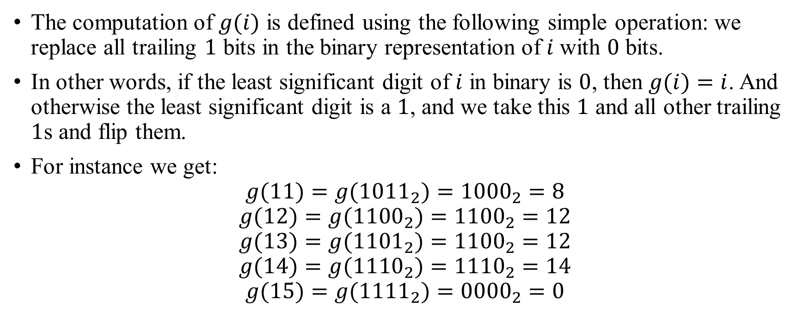
Fenwick tree Definition of g(i)
The computation of $g(i)$ is defined using the following simple operation: we replace all trailing $1$ bits in the binary representation of $i$ with $0$ bits.
In other words, if the least significant digit of $i$ in binary is $0$, then $g(i)=i$. And otherwise the least significant digit is a $1$, and we take this $1$ and all other trailing $1$s and flip them.
For instance we get:
$$g(11)=g({1011}_{2})={1000}_{2}=8$$
$$g(12)=g({1100}_{2})={1100}_{2}=12$$
$$g(13)=g({1101}_{2})={1100}_{2}=12$$
$$g(14)=g({1110}_{2})={1110}_{2}=14$$
$$g(15)=g({1111}_{2})={0000}_{2}=0$$

Slide 9
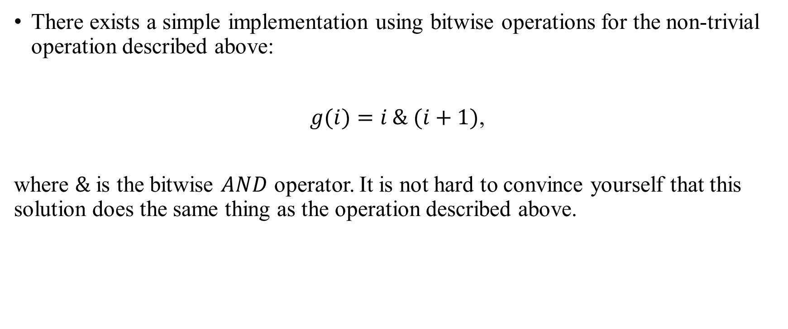
Fenwick tree Definition of g(i)
There exists a simple implementation using bitwise operations for the non-trivial operation described above:
$g(i)=i \& (i+1)$,
where $\&$ is the bitwise $AND$ operator. It is not hard to convince yourself that this solution does the same thing as the operation described above.

Slide 10
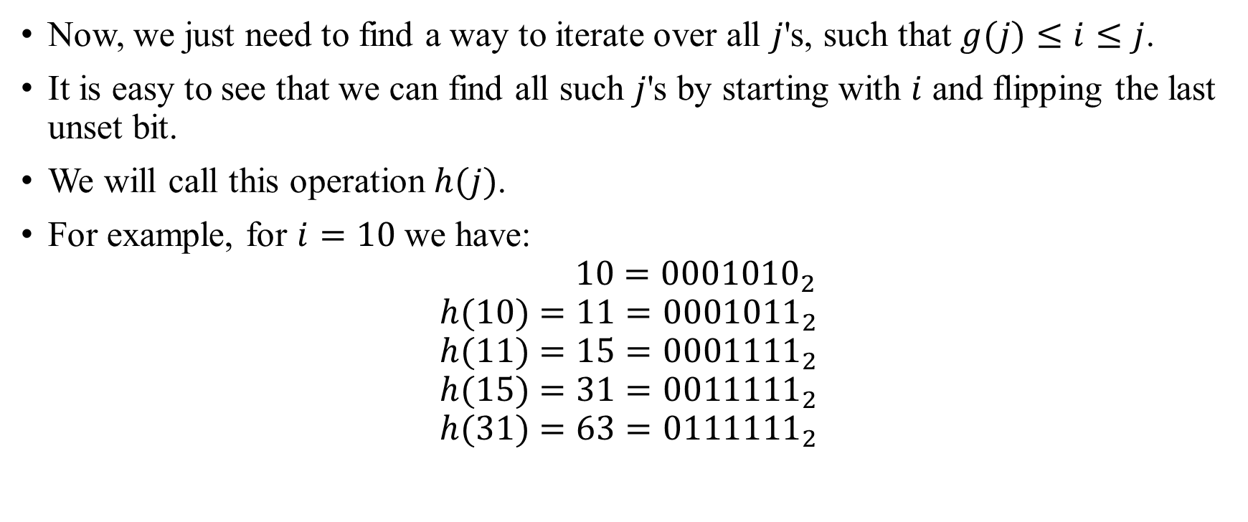
Fenwick tree Definition of g(i)
Now, we just need to find a way to iterate over all $j$'s, such that $g(j)≤i≤j$.
It is easy to see that we can find all such $j$'s by starting with $i$ and flipping the last unset bit.
We will call this operation $h(j)$.
For example, for $i=10$ we have:
$$10={0001010}_{2}$$
$$h(10)=11={0001011}_{2}$$
$$h(11)=15={0001111}_{2}$$
$$h(15)=31={0011111}_{2}$$
$$h(31)=63={0111111}_{2}$$

Slide 11

Fenwick tree Definition of g(i)
Unsurprisingly, there also exists a simple way to perform $h$ using bitwise operations:
$$h(j)=j | (j+1),$$
where | is the bitwise OR operator.

Slide 12
Fenwick tree Definition of g(i)
The following image shows a possible interpretation of the Fenwick tree as tree. The nodes of the tree show the ranges they cover.
7
3
1
5
0
2
4
6
0
1
2
3
4
5
6
7

Slide 13
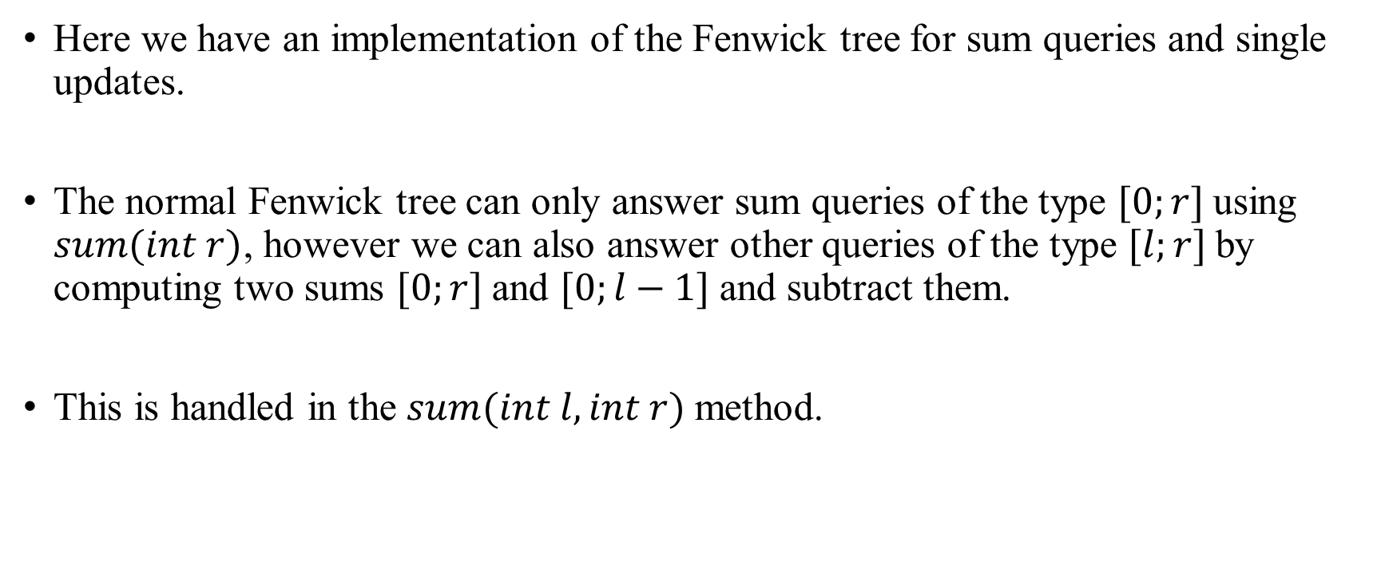
Fenwick tree Finding sum in one-dimensional array
Here we have an implementation of the Fenwick tree for sum queries and single updates.
The normal Fenwick tree can only answer sum queries of the type $[0;r]$using $sum(int r)$, however we can also answer other queries of the type $[l;r]$by computing two sums $[0;r]$and $[0;l−1]$and subtract them.
This is handled in the $sum(int l, int r)$method.

Slide 14
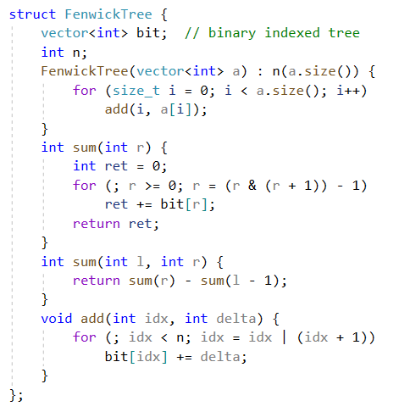
Fenwick tree Finding sum in one-dimensional array

Slide 15
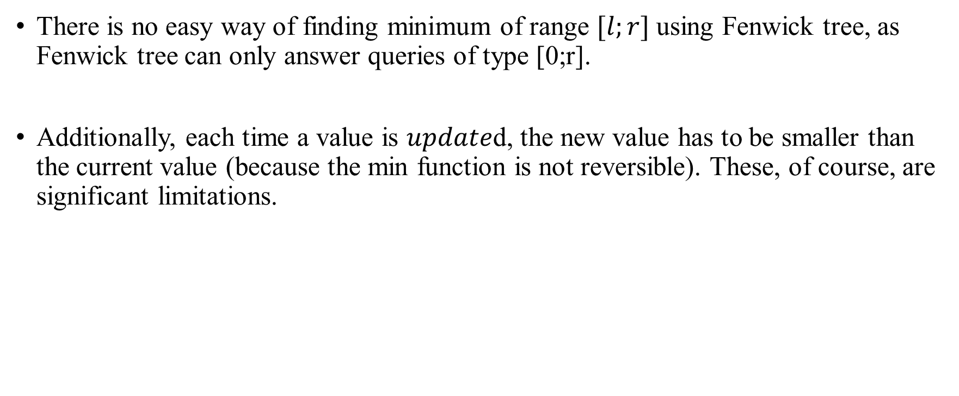
Fenwick tree Finding minimum of [0;r] in one-dimensional array
There is no easy way of finding minimum of range $[l;r]$using Fenwick tree, as Fenwick tree can only answer queries of type [0;r].
Additionally, each time a value is $update$d, the new value has to be smaller than the current value (because the min function is not reversible). These, of course, are significant limitations.

Slide 16
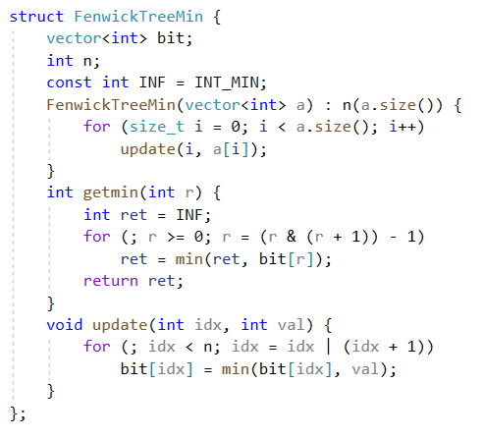
Fenwick tree Finding minimum of [0;r] in one-dimensional array

Slide 17
Fenwick tree Finding minimum of [0;r] in one-dimensional array
Note: it is possible to implement a Fenwick tree that can handle arbitrary minimum range queries and arbitrary updates.
The paper Efficient Range Minimum Queries using Binary Indexed Trees describes such an approach.
However with that approach you need to maintain a second binary indexed tree over the data, with a slightly different structure.
The implementation is also a lot harder compared to the normal implementation for sums.

Slide 18
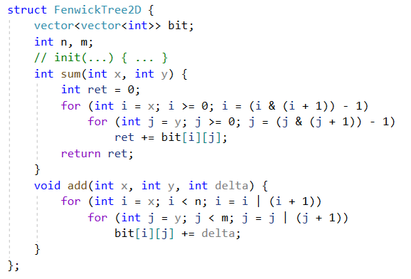
Fenwick tree Finding sum in two-dimensional array
It is very easy to implement Fenwick Tree for multidimensional array.

Slide 19
Fenwick tree
You can find all this theory here.
And here you can find problems.

